Slide 1
Software Design
Sequence Diagram &
UML Modeling Example
Slides are adapted from various software engineering classes offered by Prof. Tao Xie at UIUC

Slide 2
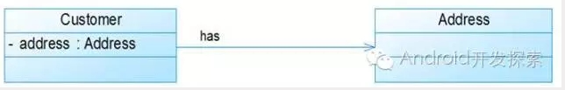

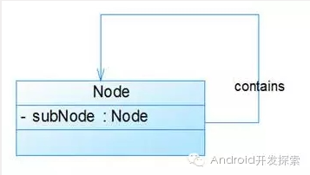
Recap

Slide 3
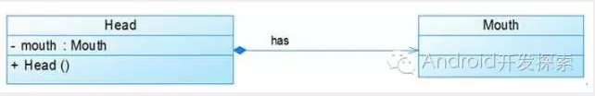
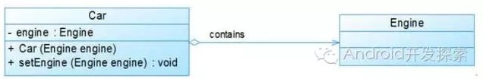

Recap

Slide 4
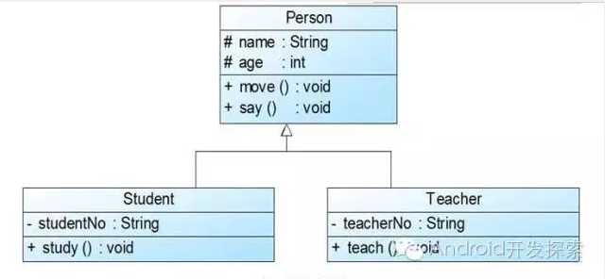
Recap

Slide 5
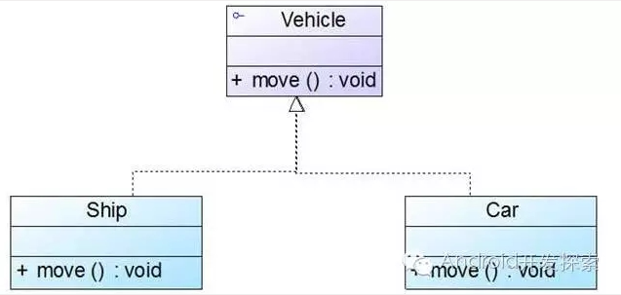
Recap

Slide 6
GroupExercise
Monopoly
Form 3-5 students groups, read through the class diagrams designed by different group, discuss their pros & cons
Will ask every group to share their opinion

Slide 7
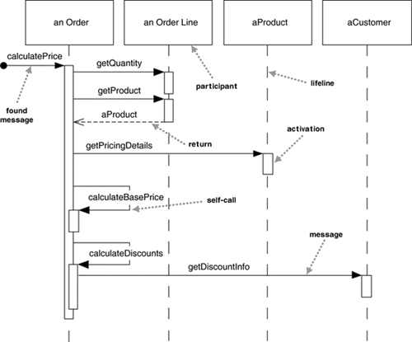
Sequence diagram (event trace)
Model how a set of objects communicate
Describe sequence of events
A line for each object
Time goes from top to bottom
Arrows represent communication events
time
A sequence diagram for centralized control

Slide 8
UML Sequence Diagrams
A sequence diagram for centralized control
Used during requirements analysis
To refine use case descriptions
To find additional objects (“participating objects”)
Used during system design
to refine subsystem interfaces
Objects are represented by columns
Messages are represented by arrows
Activations of an operation are represented by narrow rectangles
No significance to the horizontal orderings of the objects
Return values are optionally indicated using a dashed arrow with a label indicating the return value
Suggestion: not to indicate the return values when it is obvious what is being returned
Notes:
Sequence diagrams are often used to depict a chronologically-structured scenario through a use case – and in the process the necessary classes emerge. A scenario is a sequence of actions that illustrates behavior. A scenario may be used to illustrate an interaction or the execution of a use case instance.
A sequence diagram has two dimensions: the vertical dimension represents time; the horizontal dimension represents different objects. Initiation of the sequence starts in the top-left corner, and time proceeds down the page (from top to bottom). The vertical line is called the object’s lifeline. There is no significance to the horizontal ordering of the objects.
A message sent from one object to another is shown as an arrow from the line of the sender to the line of the receiver. Each message is labeled at a minimum with message name. You can optionally include the arguments containing information that needs to be passed with the message. The reception of a message triggers a corresponding operation to execute. During this execution, other messages may be sent to other objects, and eventually the methods end. An object may send a message to itself. This is shown by an arrow from the object line to the same line.

Slide 9
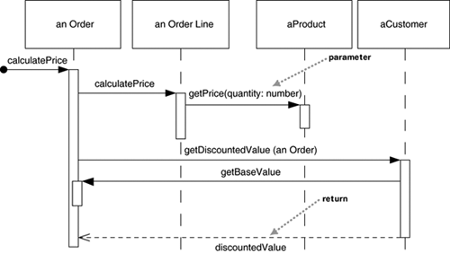
Sequence Diagram for Distributed Control
Notes:
You begin to create a sequence diagram by writing a scenario and highlighting all the nouns in the scenario. The nouns generally become the objects that appear in the columns. For example, consider the following scenario. The unique nouns are circled. Each of these nouns is likely to become an object (though not all do, as you will see with the noun “turn”).
[click] This figure shows a possible sequence diagram for this scenario.

Slide 10
Sequence Diagram for Distributed Control
Notes:
You begin to create a sequence diagram by writing a scenario and highlighting all the nouns in the scenario. The nouns generally become the objects that appear in the columns. For example, consider the following scenario. The unique nouns are circled. Each of these nouns is likely to become an object (though not all do, as you will see with the noun “turn”).
[click] This figure shows a possible sequence diagram for this scenario.

Slide 11
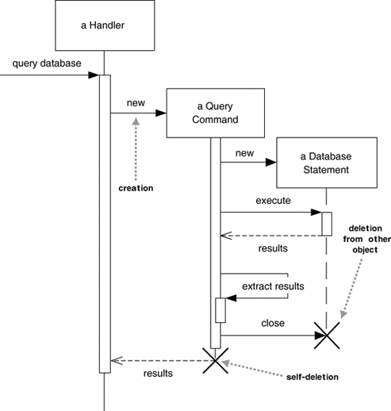
Creation & Deletion of Participants
Notes:
You begin to create a sequence diagram by writing a scenario and highlighting all the nouns in the scenario. The nouns generally become the objects that appear in the columns. For example, consider the following scenario. The unique nouns are circled. Each of these nouns is likely to become an object (though not all do, as you will see with the noun “turn”).
[click] This figure shows a possible sequence diagram for this scenario.

Slide 12
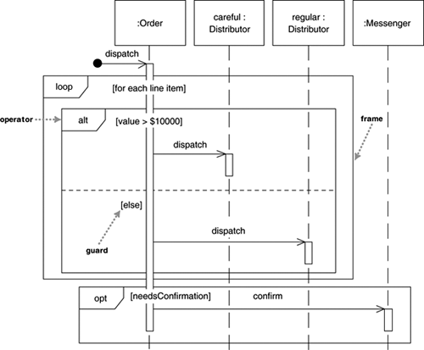
Interaction Frames
procedure dispatch
foreach (lineitem)
if (product.value > $10K)
careful.dispatch
else
regular.dispatch
end if
end for
if (needsConfirmation)
messenger.confirm
end procedure
Notes:
You begin to create a sequence diagram by writing a scenario and highlighting all the nouns in the scenario. The nouns generally become the objects that appear in the columns. For example, consider the following scenario. The unique nouns are circled. Each of these nouns is likely to become an object (though not all do, as you will see with the noun “turn”).
[click] This figure shows a possible sequence diagram for this scenario.

Slide 13
Modeling example
Build up model bit by bit
Look at one requirement at a time
A new requirement might require
Adding to model
Changing model
Model should support all the requirements you’ve seen so far

Slide 14
Why we model this way
We can only think about one thing at a time
Criticism is easier than creation
As long as we get the right answer, it doesn’t matter how we got it

Slide 15
The Viking
A direct marketing system
Sends customized mail and e-mail
Description consists of a set of use cases
。。。

Slide 16
Use Case Diagram

Slide 17
Generating letters
A user selects a set of customers to whom they wish to send letters and a template that defines the letter format. The Viking then generates a letter per customer that is based on filling in the “pluggable” information for the template with customer-related information. The user then previews the result of expanding the template list for each of the customers.

Slide 18
Starting model
Viking
selection
Letter
customers
Customer
Template
letterFor()

Slide 19
Template
Dear <<Proper Salutation>> <<Customer Name>>
Thank you very much from ordering from us on <<Date of most recent order>>. We recently received several thousand cans of the special ingredient, …
If you are interested, please click on http://theHappyViking.com/SpecialOrder/<<special order number>>/Order.html

Slide 20
More detailed model (1)
Viking
*
selection
preview
Letter
*
customers
*
Customer
Template
letterFor()
*
TemplateComponent
stringFor()
Field
name
stringFor()
Constant
value
stringFor()
stringFor(aCustomer) {
return aCustomer.valueOf(name)}

Slide 21
More detailed model (2)
Viking
*
selection
preview
Letter
*
customers
*
Customer
Template
letterFor()
*
TemplateComponent
stringFor()
*
Property
name
value
Field
name
stringFor()
Constant
value
stringFor()
stringFor(aCustomer) {
return aCustomer.valueOf(name)}

Slide 22
Use template to create a letter for a customer
letter := empty letter;
for each component c of template, add c.stringFor(customer) to letter
If c is a Constant, c.stringFor() is c.value
If c is a Field, c.stringFor(customer) is customer.valueOf(c.name)

Slide 23
Sending letters
A user chooses from among the generated letters and decides which ones to send out and by which MailingSystem to send them. The Viking should already have information associated with each customer so it can properly distribute the letter by a particular MailingSystem; the user should not need to enter this information as part of the sending process.

Slide 24
Another model snapshot (1)
selection
Viking
Letter
*
*
customers
Customer
MailingSystem
mail()
*
Property
name
value
PostalSystem
mail()
SMTP
mail()

Slide 25
Another model snapshot (2)
Viking
*
MailingSystem
mail()
selection
*
customers
*
Customer
*
Letter
PostalSystem
mail()
SMTP
mail()
*
Property
name
value
A Customer has a property “e-mail address” and “postal address” which are used by the MailingSystems to obtain an address.

Slide 26
Adding customer information
A user knows of a new customer that she wants to add to The Viking. The user can create a new customer entry and record relevant information (Name, Salutation, Address, Recent Purchase, and anything needed by other parts of The Viking) for that customer.

Slide 27
Yet another model view
Viking
*
customers
Customer
*
Property
name
value

Slide 28
Interface for creating customer
Create New Customer
Name:
Salutation:
Address:
E-mail:
Recent purchase:
Anna Kurn
Ms.
712 Maple Ave, Toronto NY
E-mail: akurn@fipster.com
#e45

Slide 29
Template creation
A user creates a new template either from scratch or by copying an existing template. A template needs to support both constant and “pluggable” information, and a user should be able to create a template and preview its appearance.

Slide 30
UML for template (1)
Viking
Template
letterFor()
*
TemplateComponent
stringFor()
Field
name
stringFor()
Constant
value
stringFor()

Slide 31
UML for template (2)
Viking
TemplateParser
Template
letterFor()
*
TemplateComponent
stringFor()
Field
name
stringFor()
Constant
value
stringFor()

Slide 32
User interfaces
Generate letters (select a set of customers and a template) and preview them
Select letters to send and the mailing system to use
Create new customer and enter info
Create new template and preview it

Slide 33
Delivery monitoring
A user reviews the letters to see which have been sent and whether any of them have “failed delivery”. If so, the user can choose to resend them either by the same Mailing System or by a different one. Also, to support this story, the Mailing System must be able to tell The Viking which sent letters “failed delivery”.

Slide 34
UML for mailing (1)
Viking
*
MailingSystem
mail()
*
Letter
PostalSystem
mail()
SMTP
mail()

Slide 35
UML for mailing (2)
Viking
*
MailingSystem
mail()
*
Letter
status
PostalSystem
mail()
SMTP
mail()

Slide 36
Mail delivery failure
Some failures are permanent (“no such user”) and some are temporary (“mailbox full”). Need different status for each.
Can have secondary addresses.
“Select permanent failures and send to secondary address” is special case of “select messages and send them”
Need UI for changing status

Slide 37
Customer selection by criteria
Upgrade the template from Story#1 to support selecting the set of customers by various search criteria. For example, select all customers who spent more than US$100 on their most recent order, or all customers who have ever bought a particular product.

Slide 38
Some questions to ask
What query language?
SQL?
Dialog box?
What criteria?
Any history?
Orders, products
Change the UI for “select customers”

Slide 39
Conclusion
Only half done
Process to finish is the same
Each step makes progress
Keep track of open issues and make sure they get resolved
Amount you write down depends on how much you remember

